Slide 1
Target of blood pressure in ckd
Effat razeghi, md

Slide 2
Introduction
Around 850 million people worldwide have CKD and >80% of them have hypertension
High blood pressure is an important risk factor for CKD and its progression and CVD
Mortality from CKD is projected to become the fifth leading cause of death by 2040.
Among many question concerning the optimal management of high BP in CKD, setting targets for BP control is crucial

Slide 3
Causes of hypertension in CKD
Renin – angiotensin- aldosterone system
Sympathetic nervous system
Endothelial dysfunction
Insulin resistance
Hyperparathyroidism
Reduce nephron mass

Slide 4
The main point of discussion
History of the recommendation of BP targets
Major guidelines on BP targets for CKD
Challenges
Treatment and key points

Slide 5
Establishment of target of BP 140/90
VA Cooperative Study in: 143 male DBP 115-129
2nd VA Cooperative Study; 360 patients: DBP 90 -114
Clinical trail 1970s and 1980 established BP <140/90 target of BP

Slide 6
Intensive BP LOWERING in DM and CKD
Hypertension optimal treatment(HOT)
  18790 patients, age 50-80, DBP 100-115
  Target ≤90, ≤85, ≤80
  No difference in CV events
  In 1501 DM major CV events in DBP ≤80 was lower than ≤90
MDRD :840 CKD non DM
  MEAN BP 92 vs 107
  Proteinuria>1g/d intensive BP control slow decline in GFR
*2003 JNC 7 recommended a treatment target BP of 140/90 and BP goal <130/80 for DM and CKD

Slide 7
Revision of target BP to 140/90 for all hypertension regardless of associated conditions
Accord Study in 2010 :benefits of BP control in DM
  4733 patients(BP <120 vs <140) follow up 4.7 yr
  Not reduce fetal and non fetal CV reducing rate of stroke
  For CKD the evidence for benefits was unclear
REINS2 Study
AASKD
  Intensive BP control failed to show benefits in slowing progression of KD
Based these ,ESH/ESC(2013) & 2014 JNC 8 recommended target <140/90
DBP 85 for DM (European guide)

Slide 8
Back to 130/80: intensive BP treatment for all hypertensive
SPRINT:2015
  9361 patients without DM,age > 50 relatively high risk . AOBP was used
  BP <120 vs <140
  Trial was stopped in 3.26 yr due to significant CV risk reduction
Subsequent meta-analysis of BP lowering trials demonstrated benefits especially at high CV risk
ACC/AHA
ESH/ESC
*Intensive BP lowering may be beneficial but too much reduction 120/70 ?

Slide 9
Current recommendation
ESC guideline:
KDIGO :

Slide 10
From KDIGO 2012 to KDIGO 2021
KD1GO 2012
  BP < 140/90 in CKD non diabetic, normoalbuminuric
  BP < 130/80 in CKD with albuminuria and transplant patients
  No recommendation for dialysis patients
KD1GO 2021
  BP < 120/80 in CKD when tolerated
  Provide guide how to measured office BP

Slide 11
From ESC/ESH 2018 to 2021
2018 ESC/ESH
  Therapy for patients with CKD> 80 yr started in BP ≥ 160/90
  Threshold in younger was ≥ 140/90
  Target was the same for adult CKD of all ages 130-139 / 70-79
  Younger with no CKD and diabetes 120-129
ESC 2021
  Decrease differential SBP thresholds at which to initiate therapy based on age
  Still recommends a higher SBP target 130-130 in adults with CKD at any age
  Younger people in the general population or I DM 120-130 if <70 and 130-139 if ≥ 70

Slide 12
Key question regarding the discrepancy in SBP targets between KDIGO and ESC 2021
Do the new guidelines cite different evidence of their BP targets in CKD
Do they recommend different methods to measure office BP
Does the guideline ESC 2021 acknowledge the earlier guidelines in the same year (KDIGO)
Does the ESC explain why its BP targets differ from KDIGO

Slide 13
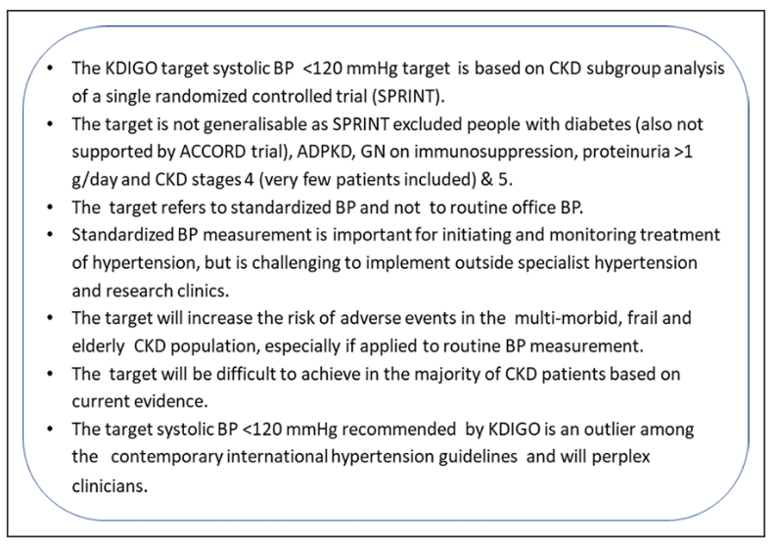

Slide 14
International guideline target BP
JNC 7 :
  General BP goal is < 140/90
  Goal of < 130/80 for DM or CKD
JNC 8:
  Less than 140/90 in 18-59 yr without comorbidities
  In patients 60 or older with DM or CKD or both goal is < 140/90
  60 or older without DM or CKD < 150/90
ACC/AHA 2017: target of < 130/90
ESC/ESH: recommends SBP 130-139
  National institutes for health and care: < 140/90 in CKD and ACR<70
  And SBP 120-129 for CKD and ACR >70 mg/mol
KDIGO (2021): recommends SBP<120

Slide 15
Target BP in CKD
Intensive BP control compered with conventional During trial
Intensive BP control mean ≤ 92 (e.g BP ≤ 120/85) compered with usual control a mean BP ≤ 107 ( e.g. BP ≤140/90) in extended follow up
SPRINT
  Non DM patients at a high risk of CVE BP < 120 compared with < 140
  results: lower rates of CV events and all causes of mortality
  Of the 9361 cases 2646 had an eGFR <60 and 1723 had a urine ACR of ≥ 30 risk reduction was similar

Slide 16
More intensive VS less intensive
Reduce risk of ESRD in patients with CKD and proteinuria
May reduce mortality in patients with CKD
Mortality benefit is most evident when patients are followed long term
* The evidence four main studies that BP target in CKD patients
(ACCORD, SPS3, SPRINT, STEP)

Slide 17
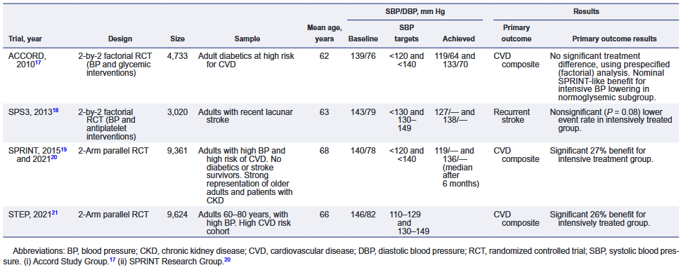

Slide 18
Safety of the low BP target
Postural hypertension
Recurrent falls and fracturs
Stroke in those with lower carotid reserve
Rapid decline in eGFR in RVD
Potential hazards of too low DBP
Polypharmacy

Slide 19
Polypharmacy
Use of ≥ 5 pharmacological agents
Common in elderly and multimorbid individual
It is associated with adverse drug reaction ,drug interaction and nonadherence
Higher direct and indirect health care cost

Slide 20
Challenges of implementation of standardized BP measurements
Requires significant resources staff training clinic space validated BP devices
Most of the early stage of CKD are cared for in primary cared
In developing country implementation standardized BP measurement is more challenging
Possibility of reconfiguration of outpatients service into virtual clinics.

Slide 21
Hypertension management in CKD
Renin-Angiotensin-Aldosterone system inhibitors:
Finerenone
New classes
  Sacubitril-valsartan
  SGLT2 inhibitors

Slide 22
Key points
Lowering BP to <120/80 increase the risk of other serious adverse events
Standardized BP measurement increase the burden on patients and resources
Evaluation home or ambulatory BP measurement as a treatment target are needed
*Targeting office BP <130/80 using an appropriate office BP
  measurement can be an option and is recommended for most adults
  al high risk of CVD
The pressure and degree of albuminuria would be considered to determine individual BP targets

